Slide 1
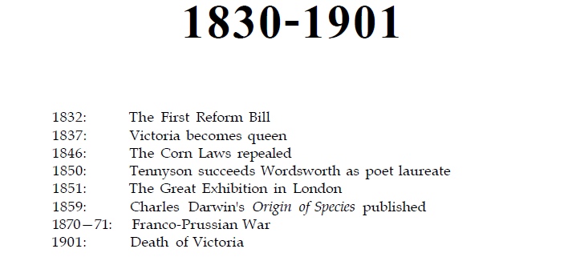
The Victorian Age

Slide 2
Industrialization, drastic developments in a short period of time.
London became the center of arts and technology, economy, banking
Writers were satisfied and disillusioned at the same time
Victorian, what it means?
John Stuart Mill, Thomas Carlyle, John Ruskin
Alfred Lord Tennyson poems
Charles Dickens, Pickwick Papers, novels
George Eliot
Bronte Sisters, Charlotte Bronte, Jane Eyre. Emily Bronte, Wuthering Heights
Matthew Arnold, Robert Browning, Elizabeth Barrett Browning
Charles Darwin, Lewis Carroll, Karl Marx
Robert Louis Stevenson, Thomas Hardy, Jane Austen, Sir Walter Scott, Benjamin Disraeli, Elizabeth Gaskell, Rudyard Kipling,
Vanity Fair, William Makepeace Thackeray

Slide 3
The Early Period (1830-1848)
1832 Reform Bill
Steam Power,
Working class and heavy conditions of working

Slide 4
The Mid-Victorian Period 1848-70
Economic prosperity, Growth of Empire, Religious controversies
Great Exhibition, colonization, India, Evangelists,
Science and technology, biology, Darwin
Decay of values and virtues

Slide 5
The Late Period 1870-1901
London as centre of everything,
Consumerism, imperialism, massacres

Slide 6
The Victorian Novel
Novel domination; popularity, profitable, moral aesthetic nature
Cultural domination; individual and national identity, the value of reading, proper aesthetic rules for fiction,
«Victorian novel is generous, expansive and deeply entertaining.»
Realism with artistic creation
Effects of Gothic narrative
Wide subjects and geographies,
Henry James: «Victorian Novel is monstrous»

Slide 7
Themes of victorian novel;
provincial politics,
ecclesiastical infighting,
city squalor, poverty, and problems in cities
making money,
losing money,
imperial adventure,
angels in the house,
scientific challanges to established religious beliefs,
value and function of the aesthetic life in a materialistic society

